Slide 1
Solar Energy Forecasting Using Weather data and Machine Learning methods
Bradley Payne

Slide 2
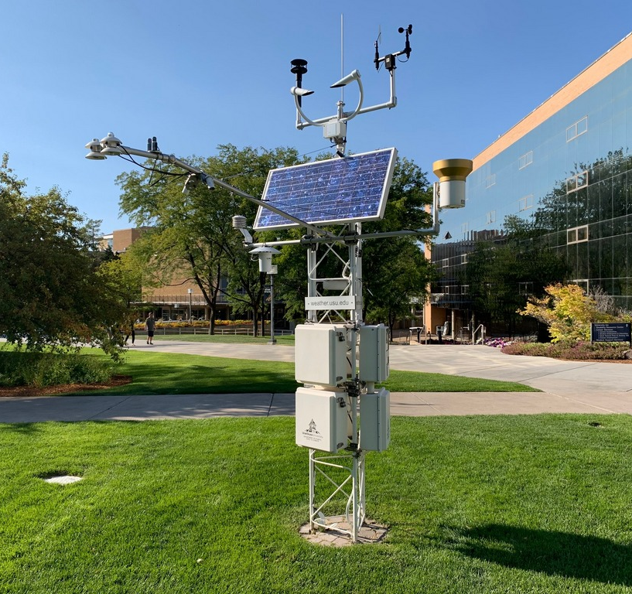
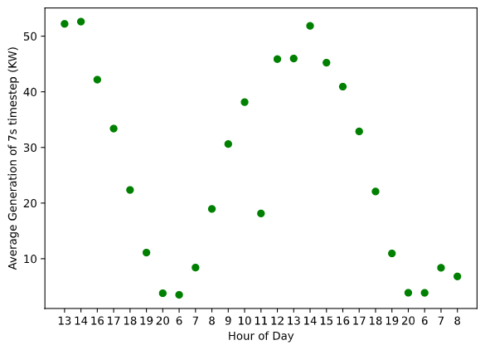
The Data
Weather Data from USU Climate center
Solar Generation from Aspire labs
USU Environmental Observatory

Slide 3
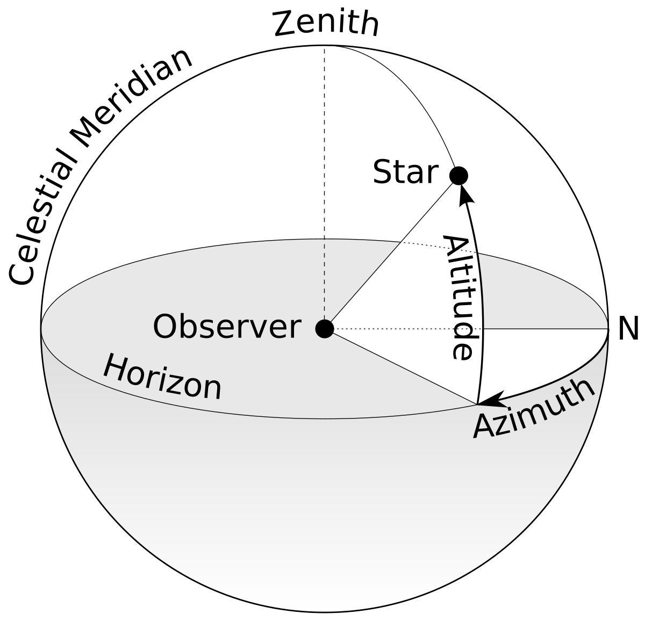
Data Curation
31% of the Solar Data was garbage collection or otherwise corrupted
Affected 44% of the hours
Experimented with using the aggregate sum of hour as well as the average produced by each timestep in a certain hour
Supplemented weather data with Azimuth, Zenith, and Elevation angle for each hour (using Astral package)

Slide 4
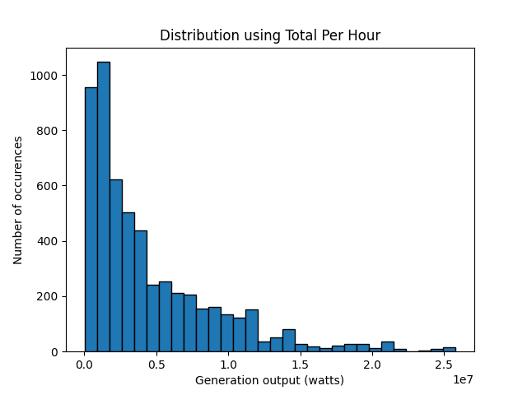
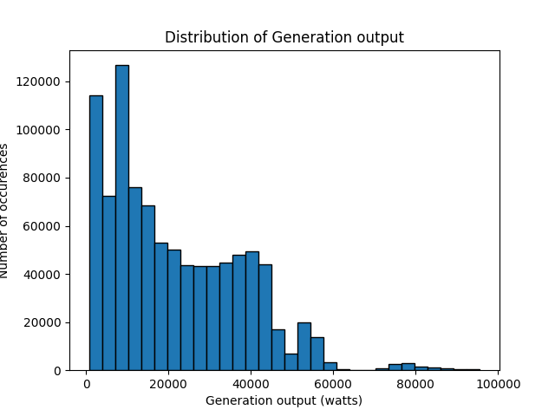
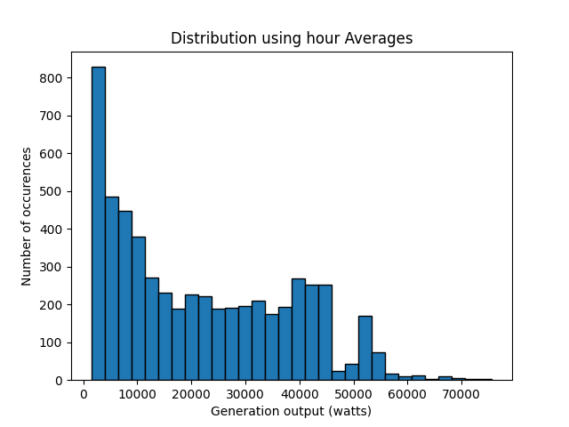
Solar Data

Slide 5
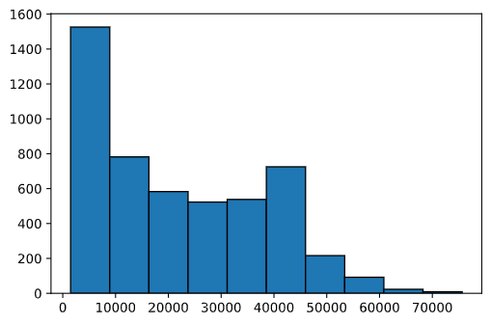
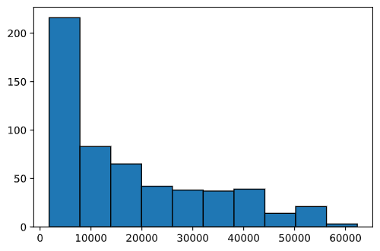
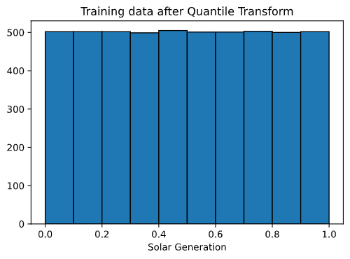
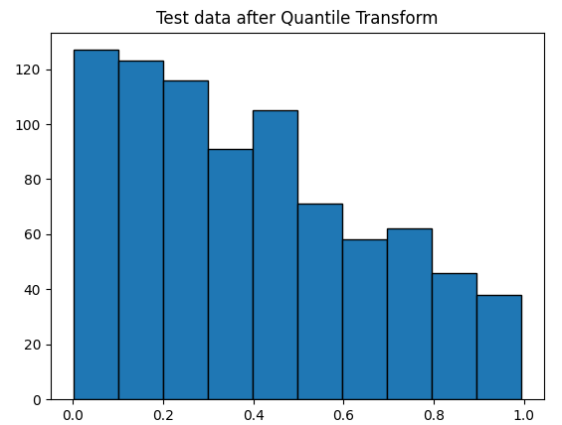
Split and transform
85 – 15 training, testing split
Transformed input data with MinMaxScaler
Transformed using QuantileTransformer
Transformation helped models

Slide 6
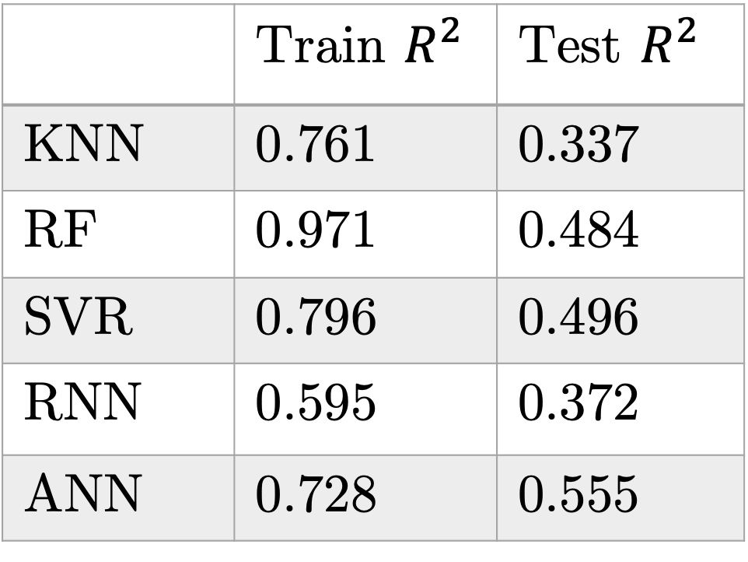
Results (on total solar)
 | Train $R^{2 }$ | Test $R^{2}$
KNN | 0.761 | 0.337
RF | 0.971 | 0.484
SVR | 0.796 | 0.496
RNN | 0.595 | 0.372
ANN | 0.728 | 0.555
K-Nearest Neighbors(KNN)
Random Forest (RF)
Support Vector Regression (SVR
Recurrent Neural Network (RNN)
{L10, L10, 10, 1}, Adam, lr 0.001, batch size 128, epochs 250, dropout 0.2
Artificial Neural Network (ANN)
{20, 10, 1} Adam, lr 0.001, batch size 50, epochs 400, dropout 0.2

Slide 7
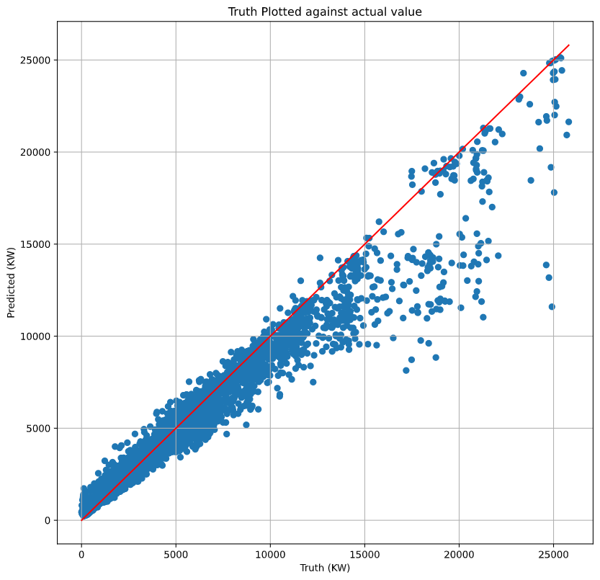
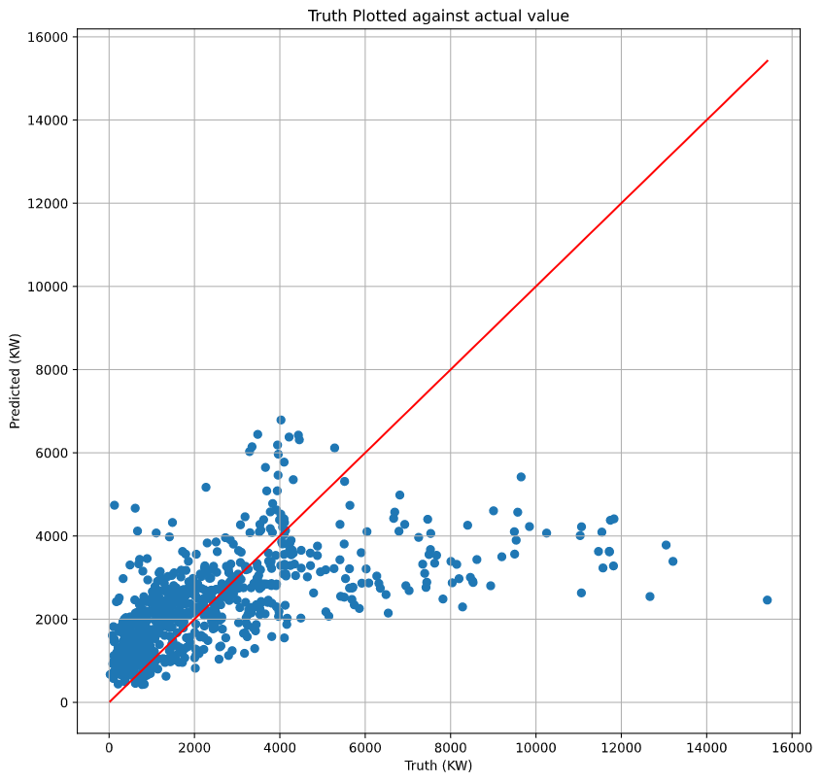
Results on Total Prediction (RF)

Slide 8
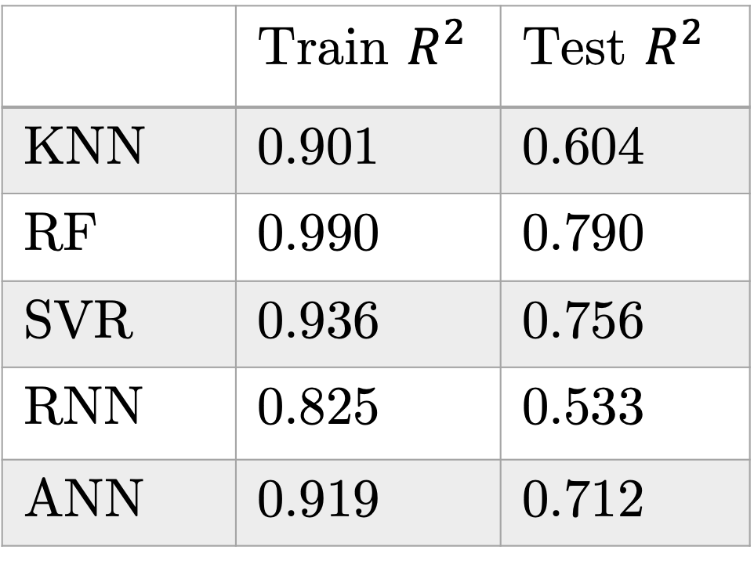
Results (on average solar)
 | Train $R^{2 }$ | Test $R^{2}$
KNN | 0.901 | 0.604
RF | 0.990 | 0.790
SVR | 0.936 | 0.756
RNN | 0.825 | 0.533
ANN | 0.919 | 0.712
K-Nearest Neighbors(KNN)
Random Forest (RF)
Support Vector Regression (SVR
Recurrent Neural Network (RNN)
{L10, L10, 10, 1}, Adam, lr 0.001, batch size 50, epochs 250, dropout 0.2
Artificial Neural Network (ANN)
{20, 10, 1} Adam, lr 0.001, batch size 50, epochs 400, dropout 0.2

Slide 9
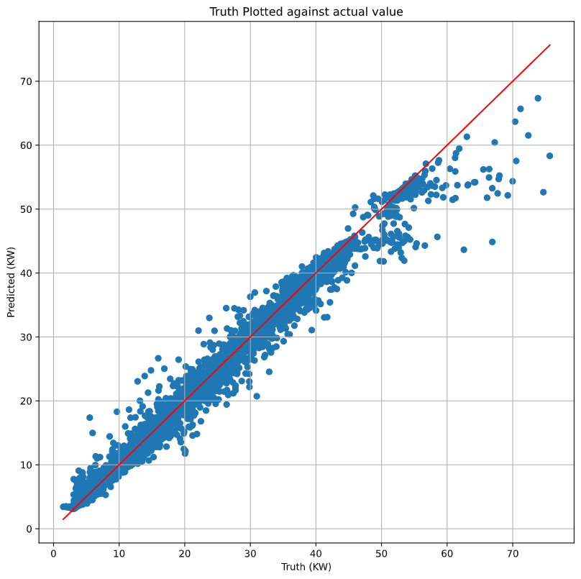
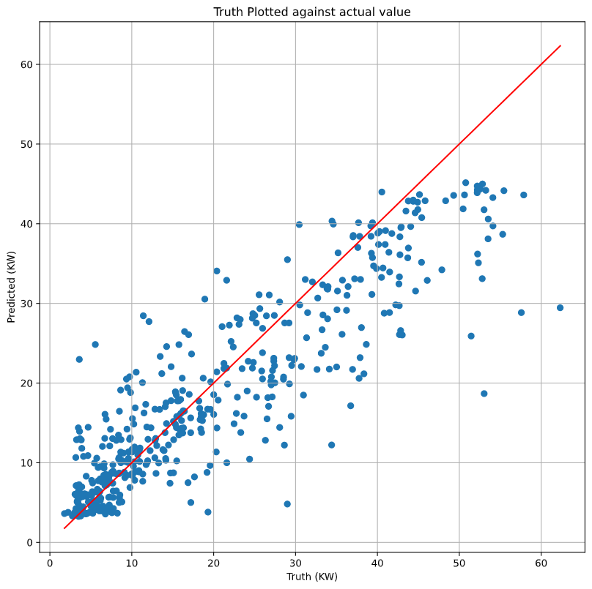


Results on Average (RF)
$$R^{2}:0.990$$
$$R^{2}:0.768$$

Slide 10
Next Tasks
Based on Research Papers’ methods:
Split data into seasons and do separate regressions [1]
Rolling average based on hour of day [2]
PCA (if time) [3]
Add Evaluation metrics of RMSE, and MAE [1, 2, 3]
For the Class:
Poster
Paper

Slide 11
Resources
[1] E. Isaksson, M. Conde. “Solar Power Forecasting with Machine Learning Techniques”. 2018.
[2] J. Torres, et al. “Deep Learning for Big Data Time Series Forecasting Applied to Solar Power”. Advances in Intelligent systems and Computing. 2019.
[3] “Forecasting of Solar Energy with Application for a Growing Economy Like India: Survey and Implication”. Renewable and Sustainable Energy Reviews. 2017.

